Slide 1
Side-effects Management and Custom Hook

Slide 2
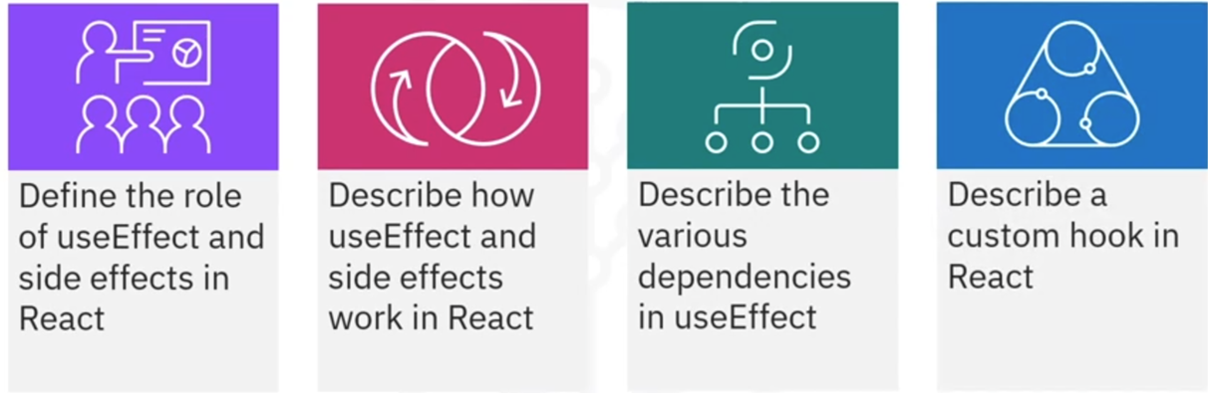
What you will learn

Slide 3
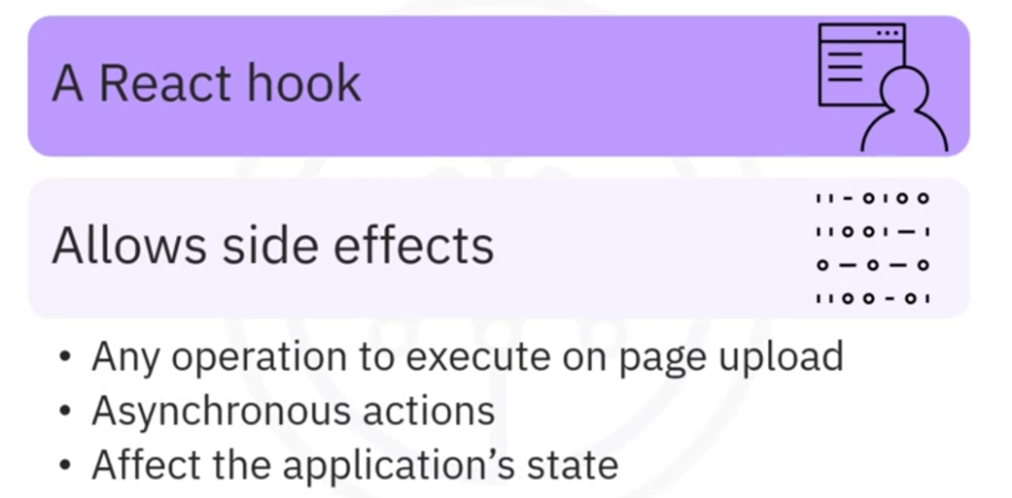
What is useEffect?

Slide 4
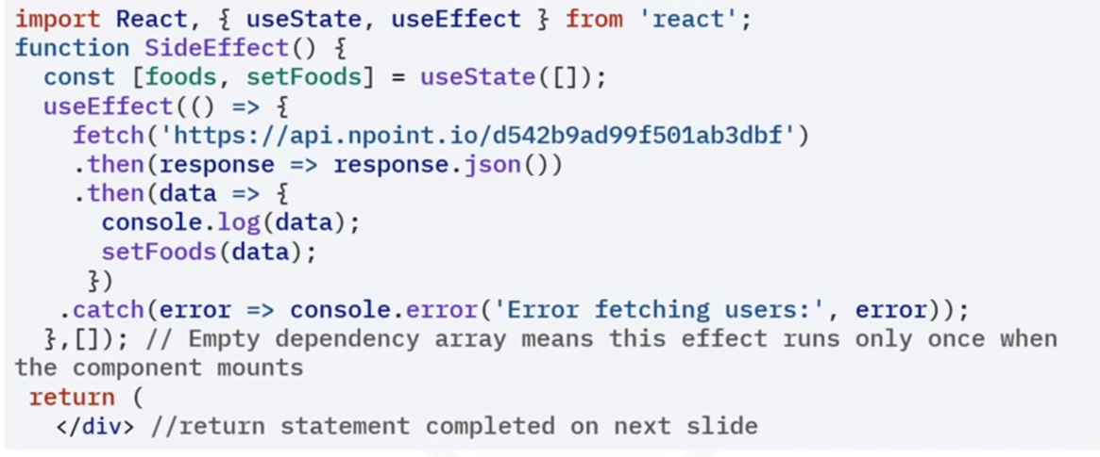
useEffect and side effects example

Slide 5
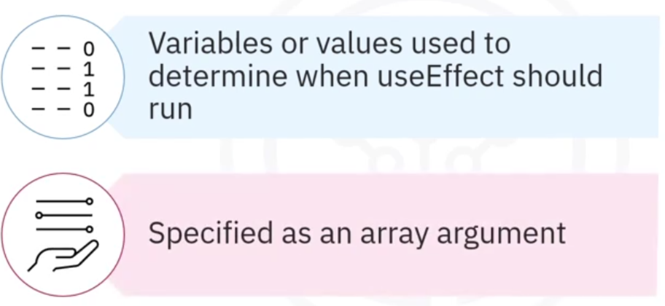
Dependencies in useEffect

Slide 6
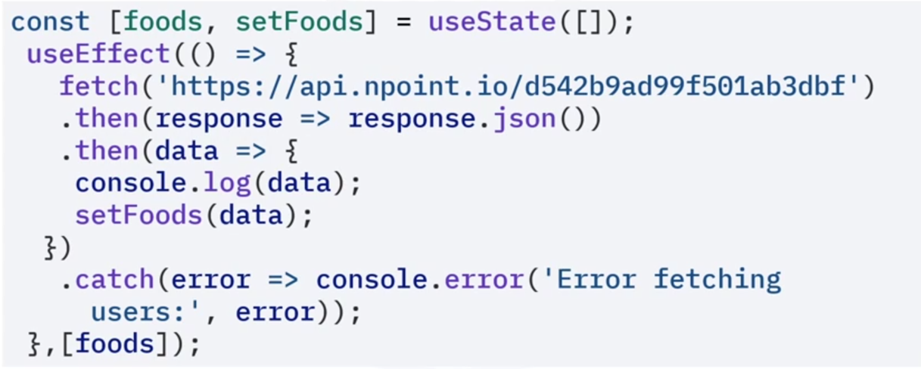
Dependency array with values

Slide 7
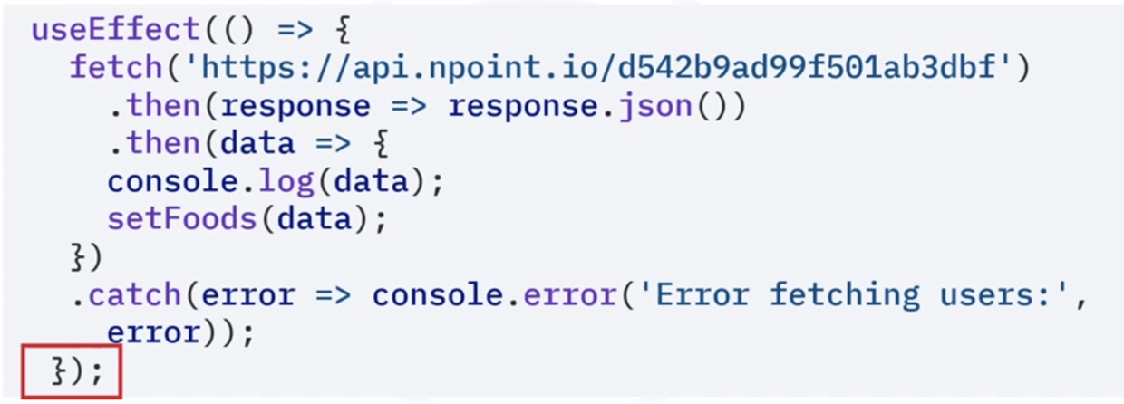
Omitting dependency array

Slide 8
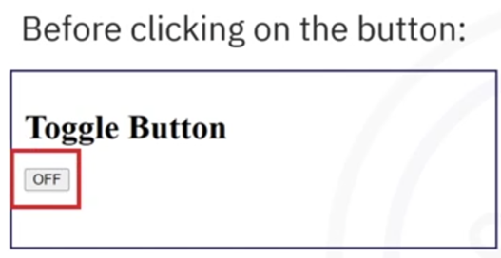
Custom hook

Slide 9
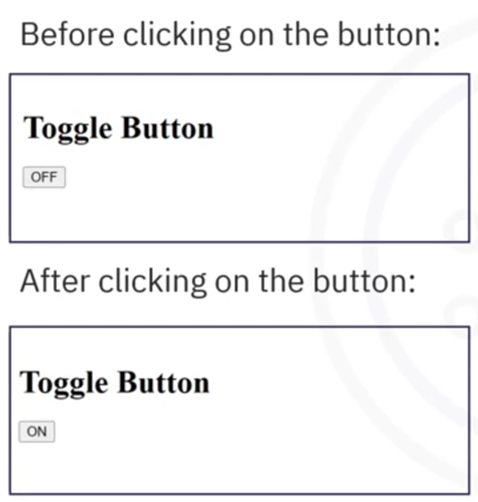
Custom hook

Slide 10
Recap
In this video, you learned that:
• useEffect is a React hook that allows you to perform side
effects in functional components
• Side effects are actions that occur asynchronously
• In React's useEffect hook, dependencies refer to variables or
values that determine when useEffect should run
• Custom hooks allow you to abstract complex logic that you can
easily reuse across different components in your application

